Slide 1
Electronic Cane for the Blind
Team 2
Samuel Aragon
Joshua Young
Vivek Patel
Francisco Sorto
Project Manager | Dr. Steven Pei
E | PEIuh4@GMAIL.COM

Slide 2





THE TEAM
Francisco Sorto
Electrical Engineer
Computer & Embedded Systems
Vivek Patel
Electrical Engineer
Power and Controls
Samuel Aragon
Electrical Engineer
Electronics
Joshua Young
Computer Engineering

Slide 3
INTRODUCTION
Visually impaired people are often not able to identify obstacles and trip hazards on their paths, and consequently they get injured.
10 Million people with a sight impairment live in the United States as of today.

Slide 4
PROJECT DESCRIPTION
Electronic device capable of detecting several obstacles such as walls, stairs, benches, etc. and providing the user with an unique feedback to avoid the obstruction
This device is intended to replace visually impaired individuals’ traditional blind cane or seeing-eye dog.

Slide 5
PROJECT GOAL
To design and construct an electronic device to be used as a cane for visually impaired individuals. This device will detect several obstacles and provide feedback to its user

Slide 6
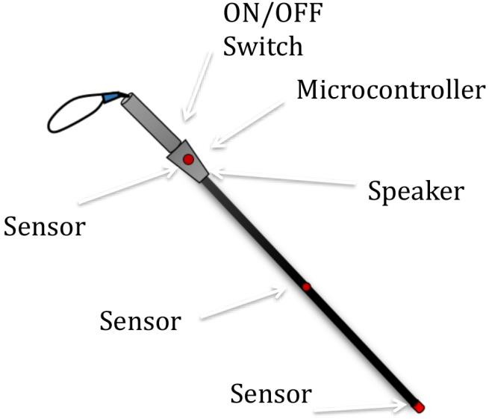
OVERVIEW DIAGRAM

Slide 7
Who will this device be designed for?
Anyone with a visual impairment or disability will be able to use this device to walk safely avoiding obstacles or trip hazards.
The device will be designed to be very intuitive and easy to operate.

Slide 8
Project Constraints
10 Hours of power supply
Three meters maximum accurate distance detection
Measuring angle of 15 degrees
Hard surfaces detection with few soft surfaces detection
Limited Budget

Slide 9

Standards
International Organization for Standardization- one of the most respected developer of standards in the world
Approved Work Item, ISO/AWI 21856 assists products for people with disabilities; assistance involves general requirements and test methods
The technical committee, ISO/TC 173, standardizes the field of assistive product and services to compensate those with disabilities.

Slide 10
Deliverables
Electronic device capable of object detection at a maximum distance of three meters
Device capable of differentiating distinct objects
Audio or Vibrating output signal for user notification
Lightweight and standard length cane

Slide 11
Device Specifications
Parameter | Value
Maximum Distance | 3 meters
Measuring Angle | 15 degrees
Power Supply Life | 10 hours
Weight | 3 Lbs
Length | 40 inches
Vibrating Motor RPM | 11000 RPM

Slide 12
Methodology Test
Implement print function to display the type of detection occurred
Utilize an oscilloscope to measure the amplitude of the vibration signal as distance changes
Approximate the Battery life by connecting it to an equivalent resistance and measure the draining time

Slide 13
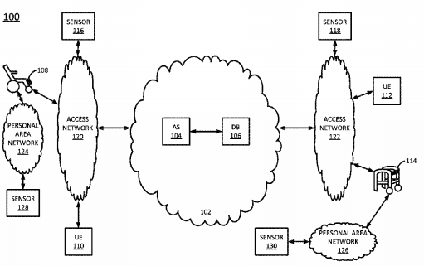
Smart Mobility Assistance Device Applicant: AT&T Intellectual Property I, L.P. Location: Atlanta, GA, US Application Number: 15/622,096 Family ID: 63685385 Filed: June 14, 2017
Abstract - In one example, the present disclosure describes a device, computer-readable medium, and method for providing smart mobility assistance. The set of sensors is to monitor an area surrounding a user of a mobility assistance device. The processor is to detect a hazard in the surrounding area, based on the monitoring. The first set of feedback mechanisms is to provide the user with an alert that notifies the user of the hazard. The communication device is to send a notification to a third party informing the third party of the hazard.

Slide 14
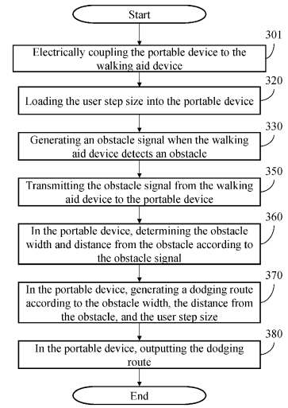
System For Guiding Blind And Method Thereof Applicant: Inventec (Pudong) Technology Corporation Location: Shanghai CN Application Number: 15/622983 Family ID: 58893532 Filed: June 14, 2017
Abstract - The present disclosure illustrates a system for guiding a blind and method thereof. In the system, a portable device is electrically coupled to a walking aid device, the walking aid device generates an obstacle signal when detecting an obstacle, an obstacle determination module may determines an obstacle width and a distance from the obstacle in accordance with the obstacle signal, and a route planning module may generate a dodging route according to the obstacle width, the obstacle distance and a user step size loaded previously. As a result, the system and the method are able to let user know about information of the front obstacle, and may achieve the effect of dodging the front obstacle safely.

Slide 15
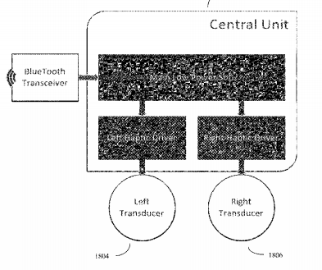
Method and device for visually impaired assistance Applicant: VasuYantra Corp. Location: Milpitas, CA US Application Number: 15/411,837 Family ID: 60022636 Filed: January 20, 2017
Abstract - A device, system, and method of assistance for visually impaired users. The system comprises a plurality of video cameras, often head mounted, computer processors and associated support devices and algorithms configured for computer vision, and a user worn haptic band comprising a plurality (two or more) of distantly spaced haptic transducers. This haptic band is worn such that user's hands are free for other tasks. The system uses its video camera, depth processing algorithms, and object recognition algorithms (hardware and/or software based) to identify a limited number of navigationally important objects. The spatial locations of each object deemed important is output to the user by varying output to the haptic transducers accordingly. The system is configured to identify and report objects as generic objects, identified objects, and potential obstacle objects. The system can also optionally provide audio information pertaining to these objects as well.

Slide 16
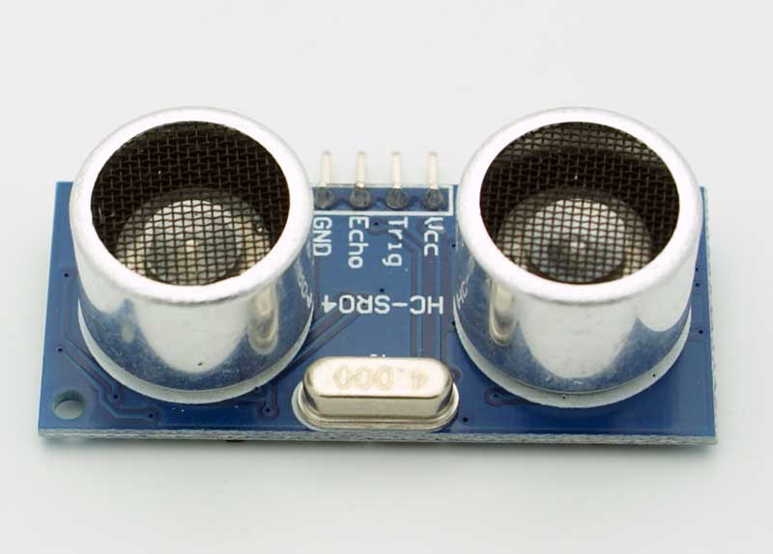
Risk Management
Ultrasonic Range Finder Sensor HC-SR04
Inaccurate detection from HC-SR04 sensors
Short Battery Life
Inefficacy to detect descending stairs steps
Mono output signal (either audio or vibration signal)

Slide 17
Backup Plan
Laser distance sensors instead of HC-SR04 Ultrasonic sensors
Power Bank instead of Solar Panel
Detect descending stair steps by contact
Vibrating signal instead of audio signal

Slide 18
LESSONS LEARNED
Time Management
Risk Analysis
Teamwork

Slide 19
FUTURE DIRECTIONS
GPS implementation
Descending stairs steps detection
Detect elevation drop using different type of sensor

Slide 20
SUMMARY
Receiving Sensor signal, Device differentiating objects detected, Vibration intensity increasing as distance changes.
Only one back up was utilized (Power bank was used as the power supply)
Project completed within the budget

Slide 21

Questions?

Slide 22
References
National Federation of the Blind. (2018). Fact Sheet Blindness and Low Vision. [online] Available at: https://nfb.org/fact-sheet-blindness-and-low-vision [Accessed 27 Feb. 2018].
Cdc.gov. (2018). CDC - Burden of Vision Loss - About Vision Health - Vision Health Initiative (VHI). [online] Available at: https://www.cdc.gov/visionhealth/basic_information/vision_loss_burden.htm [Accessed 27 Feb. 2018].
Pinsdaddy.com. (2018). Laser Canes For The Blind Pictures to Pin on Pinterest - PinsDaddy. [online] Available at: http://www.pinsdaddy.com/laser-canes-for-the-blind_hVQRPC6rZ6VaLmszkwfRWoUle5kfRW4R5avDKCv7clQ/ [Accessed 27 Feb. 2018].

